Slide 1
PROJECT -1
THE EFFECTS OF AIR QUALITY ON PHYSICAL ACTIVITY AND NUTRITION ANALYSIS IN 2017
By Soujanya, Brittany, & Leah

Slide 2

OUTLINE
Data Motivation
Final Idea & Data Sources
Hypothesis
Exploring the Data
Cleaning the Data
Data Analysis
Conclusions, Limitations, & Final Thoughts
Sources

Slide 3
DATA MOTIVATION - THE ORIGINAL IDEA
Denver
Parking
Data
How many parking meters/lots were in Denver
What areas were most densely populated with parking meters/lots
What areas were priced highest and lowest
Limitation: Parking data is not free

Slide 4
FINAL DATA DESCRIPTION & SIZE
We used Air Quality API and Nutrition and Behavioral data (csv file) (sources listed in the last slide)
We chose to analyze the level of air pollutants versus the percent of people engaging in physical activity and nutritional food
Data size - csv file - 63,000 rows, 33 columns
We filtered it down to use only 2017 data since that was the most recent and significant among the ones, we found
Final csv data file size - 12329 rows × 4 columns

Slide 5
HYPOTHESIS
As the level of air pollutants increases, the percent of people engaging in physical activity and nutritional food decreases.
Searched air pollutants through the EPA, found the API with measurements from sites across the country, and found average levels of NO₂ and ozone in 2017.
Pulled the health data from CDC source determining levels of physical activity, obesity, and nutrition per state.
Comparing the data initially allowed us to question if air pollution was correlated to health data. Could a study about obesity, physical activity, and nutritional choices show people were impacted by outside factors such as pollution? Assumed there would be a negative correlation. Began forming hypothesis around this information.

Slide 6

PARAMETERS
Nitrogen Dioxide and Ozone are two air pollutants recognized as harmful to humans by the EPA and both are regulated in the United States.
They are released in the air most often due to burning of fossil fuels. EPA is required to monitor levels and has testing sites all over the country.
2017 produced significant data across both sources and it was interesting to study more recent findings.

Slide 7
WHY NITROGEN DIOXIDE & OZONE
The EPA has identified six pollutants as “criteria” air pollutants because it regulates them by developing human health-based and/or environmentally-based criteria (science-based guidelines) for setting permissible levels. These six pollutants are carbon monoxide, lead, nitrogen oxides, ground-level ozone, particle pollution (often referred to as particulate matter), and sulfur oxides.
Source: https://www.cdc.gov/air/pollutants.htm
On our API, we had all parameters available for Nitrogen Dioxide and Ozone among the 6 pollutants.

Slide 8
EFFECTS OF NO2 & O3
NO2 - NO₂ can irritate airways in the human respiratory system. Such exposures over short periods can aggravate respiratory diseases, particularly asthma, leading to respiratory symptoms (such as coughing, wheezing or difficulty breathing), hospital admissions and visits to emergency rooms. Longer exposures to elevated concentrations of NO₂ may contribute to the development of asthma and potentially increase susceptibility to respiratory infections.
Ozone - People most at risk from breathing air containing ozone include people with asthma, children, older adults, and people who are active outdoors, especially outdoor workers. In addition, people with certain genetic characteristics, and people with reduced intake of certain nutrients, such as vitamins C and E, are at greater risk from ozone exposure. Breathing ozone can trigger a variety of health problems including chest pain, coughing, throat irritation, and airway inflammation. It also can reduce lung function and harm lung tissue. Ozone can worsen bronchitis, emphysema, and asthma, leading to increased medical care.
Ozone also affects sensitive vegetation and ecosystems, including forests, parks, wildlife refuges and wilderness areas. In particular, ozone harms sensitive vegetation during the growing season

Slide 9
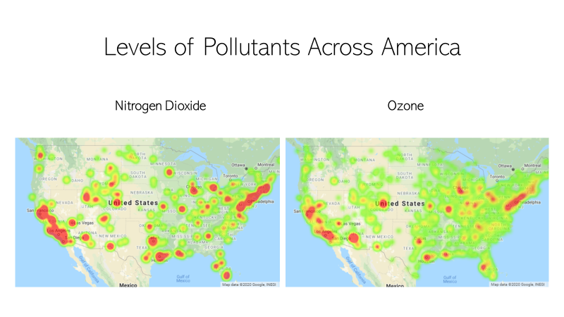

Slide 10
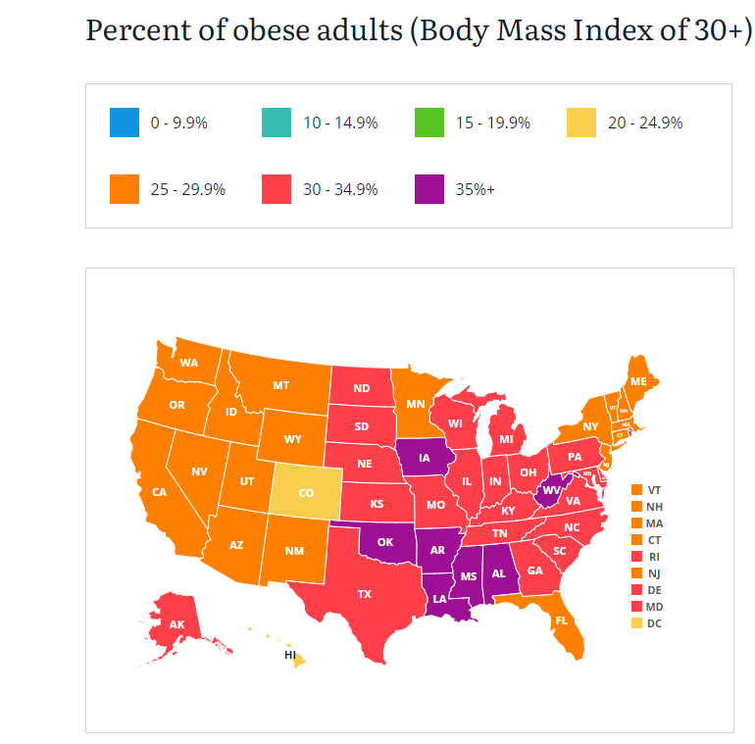
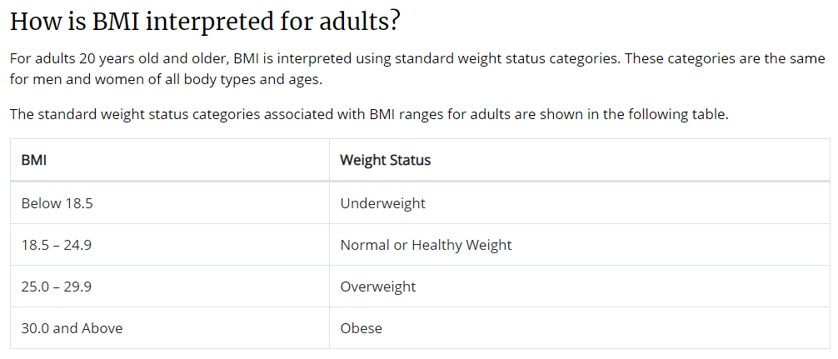
BMI – measure of body fat based on height and weight
https://www.cdc.gov/healthyweight/assessing/bmi/adult_bmi/index.html#InterpretedAdults
https://stateofchildhoodobesity.org/methodology/
Source:https://stateofchildhoodobesity.org/adult-obesity/

Slide 11
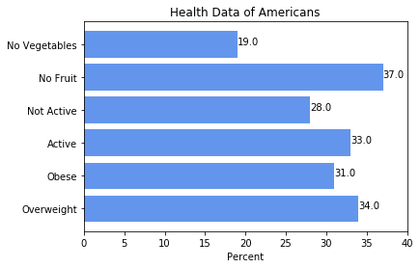
HEALTH DATA VALUES
Percent of Americans who:
Are overweight
Are obese
Engage in physical activity
Engage in no physical activity
Eat less than one fruit per day
Eat less than one veggie per day

Slide 12
CLEANING THE DATA – AIR QUALITY
API
Set up query url
Loop through each state in the pull request
The loop extracted each data point into a list, which we put in a DataFrame
The result was 912 data points
Consolidated by state
Converted to float types

Slide 13
CLEANING THE DATA – HEALTH
CSV File was 63000 rows and 33 columns
Extracted only the columns needed
Extracted only data from 2017
.loc
Dropped a couple of states
Puerto Rico and Virgin Islands
Consolidated 4 similar health questions into 1
.replace
Grouped by state and added some calculated columns
.groupby and .agg
Renamed the columns so that they were no longer “stacked” and one column name matched out other dataset to prepare for a merge
Create individual DataFrames for each question
Merged each question with our air pollution data

Slide 14
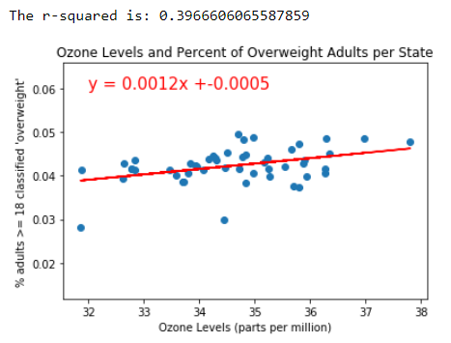
POLLUTANTS VS. OVERWEIGHT
Showed almost 39.67% of the variance in each variable accounted for by the other. This is the strongest correlation we found by comparing the average levels of ozone per state and the percent of adults classified as ‘overweight’ in those states. We could theoretically predict the ‘overweight’ classification 40% of the time by the ozone levels in that state.

Slide 15
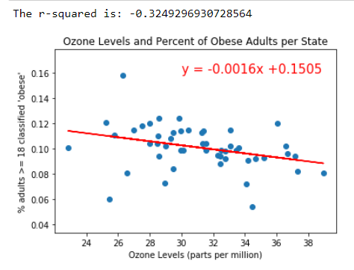
POLLUTANTS VS. OBESITY
Comparing the percent of adults classified as ‘obese’ showed a similar trend in the average levels of ozone per state as well as the maximum recorded level of ozone per state.
There was no statistical significance or correlation between the average levels of NO₂ per state and levels of obesity or overweight classifications.

Slide 16
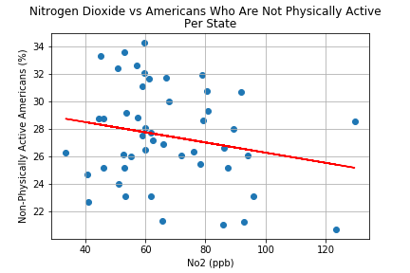
NO2 VS. PHYSICAL ACTIVITY
Correlation Coefficient -0.21
Mild negative correlation
This data shows that states reporting lower max No2 levels also report lower percentage of physically active people

Slide 17
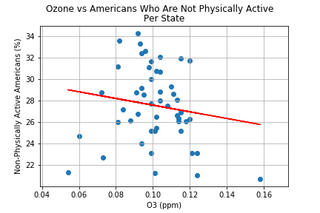
O3 VS. PHYSICAL ACTIVITY
Correlation Coefficient -0.15
Mild negative correlation
This data shows that states reporting lower max o3 levels report lower percentage of non-physically active people

Slide 18
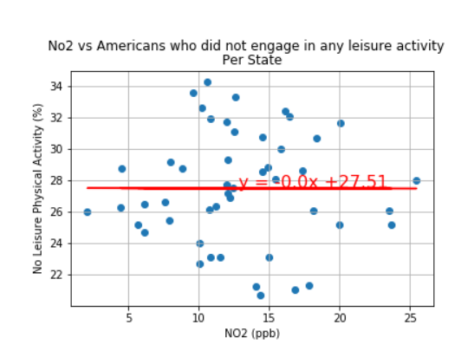
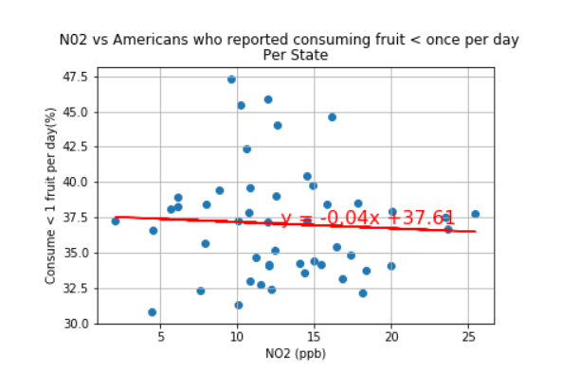
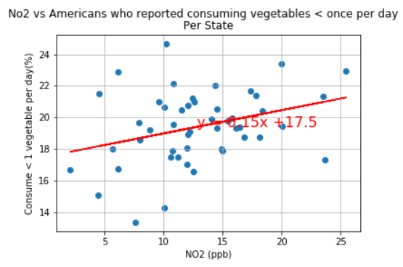
NITROGEN DIOXIDE ANALYSIS VS NUTRITION
Correlation Coefficient for No2 levels vs. all 3 Behavior and nutrition questions is -0.09
This data shows almost no correlation between consuming fruits/Vegetables less than one time daily and average No2 levels

Slide 19
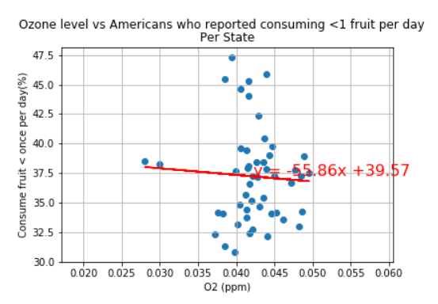
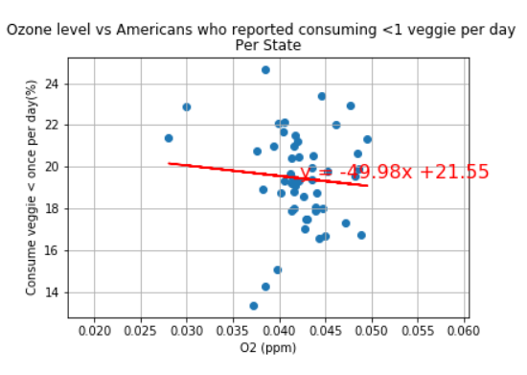
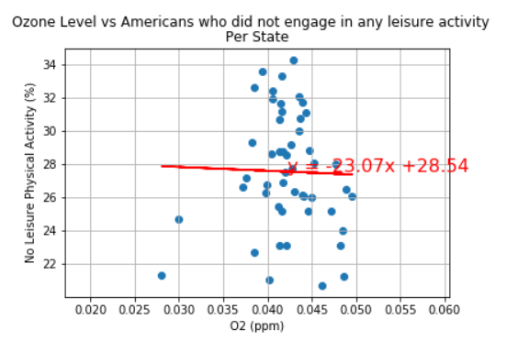
OZONE ANALYSIS VS NUTRITION & HEALTH DATA
Correlation Coefficient for all Ozone 2 levels vs. all 3 Behavior and nutrition questions is -0.09
This data shows almost no correlation between consuming fruits/Vegetables less than one time daily and average Ozone levels

Slide 20
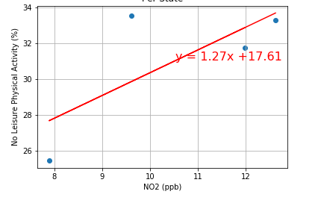
NO2 AND HIGHER BMI LEVEL STATES [BMI > 35]
There was almost no correlation between the Nitrogen Dioxide levels vs Americans who did not engage in any leisure activity in MS,OK,IO,AR

Slide 21
CONCLUSIONS AND LIMITATIONS
We could not prove our hypothesis
Maybe population density was playing a role on the air pollution
Pulled in 2017 census data and re-ran the pollution data per capita but found even greater correlations that follow the null hypothesis
Definition of “Health” was determined by the data we could find on it
Health data was self-reported questions, no measurements were used to confirm the data
Health data did not properly categorize age, ethnicity, income, etc. so we couldn’t use it
Air Pollutant data was from the EPA, who also sets the standards for acceptable levels
Some states have more data points (testing sites) than others
We had to drop some states because there was no data from one of our two source
Looking Forward – analyze more years, include timeline data or air quality

Slide 22
REFERENCES
API’s used:
https://dev.socrata.com/foundry/chronicdata.cdc.gov/hn4x-zwk7
https://aqs.epa.gov/data/api/annualData/byState?
https://aqs.epa.gov/aqsweb/airdata/FileFormats.html
CSV File:
Behavioral Risk Factor Surveillance System
https://dev.socrata.com/foundry/chronicdata.cdc.gov/8mrp-rmkw
https://chronicdata.cdc.gov/Nutrition-Physical-Activity-and-Obesity/Nutrition-Physical-Activity-and-Obesity-Behavioral/hn4x-zwk7

